Slide 1
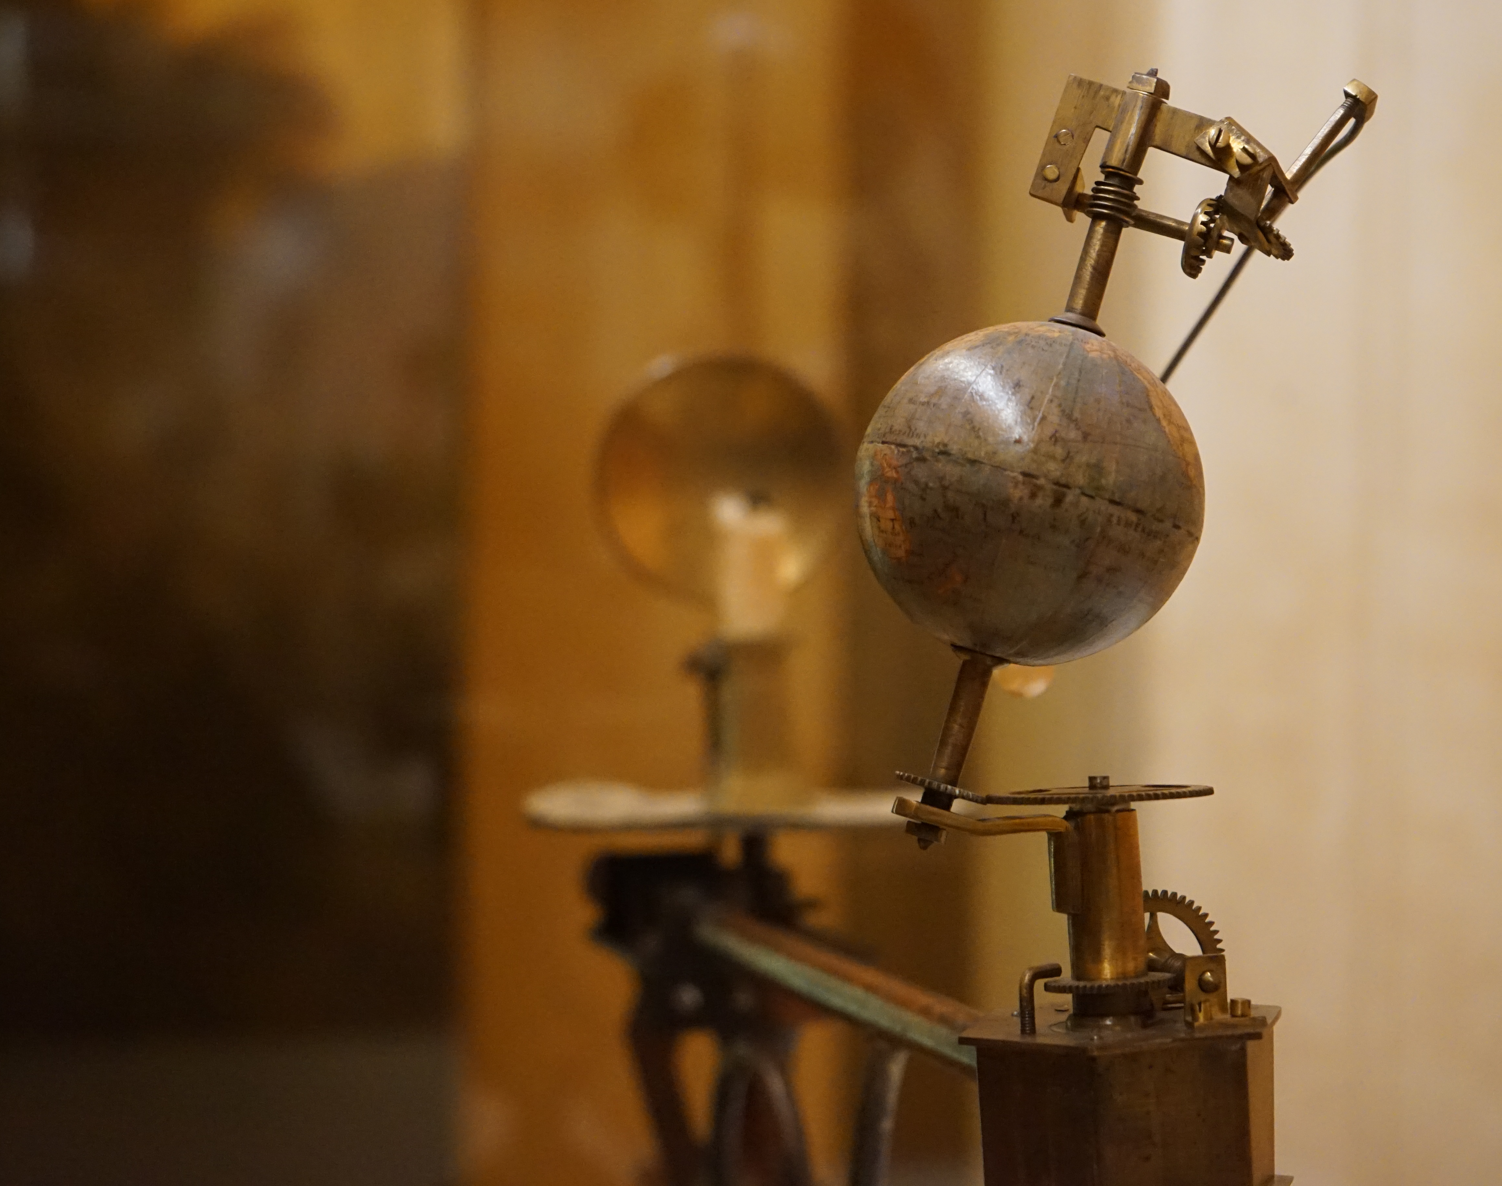
Astronomy 100/1 Lab 5
[subtitle]
Yvonne Ban
Globenmuseum, Österreichische Nationalbibliothek
Vienna, Austria
21 Oct 2017

Slide 2

Clear as day
How does the Sun move:
Throughout the year?
Throughout the day?
At different places?

Slide 3
Part 1: The Sun at noon in Amherst
Open Location window and set to Amherst Center.
Open Sky and Viewing Options window.
Under Sky:
Set Stars Absolute Scale to 0.0
Uncheck Show Atmosphere
Under Projection, select Cylinder
Under Markings:
Check Azimuthal Grid
Check Meridian

Slide 4
Part 1: The Sun at noon in Amherst
Zoom out centered on the South horizon point
Open Date/Time window and change the date to 21 September
Watch how the Sun moves from sunrise to sunset.
Adjust time to “local noon” when Sun is crossing Meridian
Plot the Sun’s altitude on the graph on your lab worksheet
Go to the next month and repeat.
Answer the questions on the Lab worksheet.

Slide 5
Part 2: The Sun’s path across the sky
Watch how the Sun moves across the sky on
21 June (summer solstice)
21 Dec (winter solstice)
Look at
where in azimuth the Sun sets on each day.
the angle at which the Sun approaches the horizon at sunset.
Answer the questions on the Lab worksheet.

Slide 6
Part : The Sun at noon at ???
Open Location window and set to
a city in the Southern Hemisphere at a latitude between S 24° to 66°
a city in the tropics at a latitude between N 23° to S 23°
Find the maximum altitude the Sun reaches at each location throughout the year, and the month this occurs.
Answer the questions on the Lab worksheet.

Slide 7
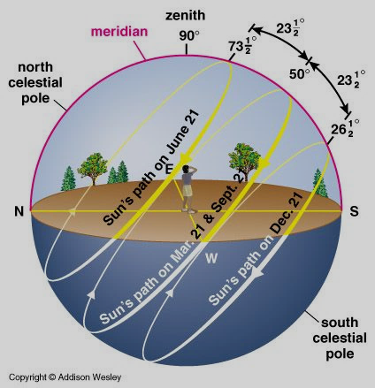
Part 4: Class activity
Earth’s axis is tilted at 23.5°
From Earth, this makes the Sun appear to move 23.5° north and south of the celestial equator.
This means that the Sun doesn’t actually pass overhead for most of the world, even at noon.

Slide 8

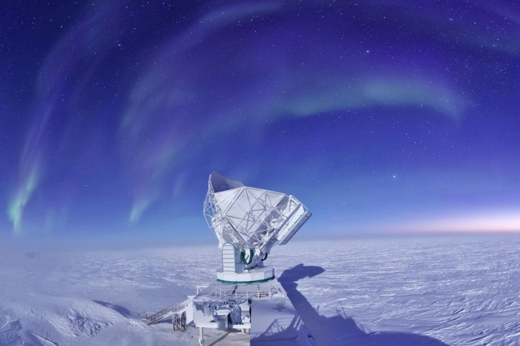
Compare: Equator vs. South Pole

Slide 9
Part 5: Quiz
Remember to enter the correct latitudes for the cities you picked in Part 2!
Make sure to fill out the end-of-Lab quiz on Moodle before you leave! IF YOU CANNOT, YOU MUST SPEAK TO YOUR LAB INSTRUCTOR BEFORE YOU LEAVE!
Bring your camera (cell phone?) with you to next week’s lab!

